Slide 1
From static to streaming data

Slide 2
What you will learn in this course 🧐🧐
As you are getting more experience as a developer, you will encounter use cases where simple SQL databases won't be a good fit.
Either because you are processing too much data at once or because you will need to write data too often the dataset. When this happens, it usually means that you need to use streaming data. In this course, we will learn:
What is streaming data?
When to use streaming data?
Pros and cons of streaming data
Useful tools to leverage streaming data

Slide 3
What is streaming data?
We use the term streams to define a continuous flow of data generated from a variety of sources. You will encounter streaming data usually when dealing with:
Internet of Things (IoT) - A building sensor sending data in real time
Video streams
Logs of servers
Mobile or Web applications that needs to process real-time data - Uber informing their users of a driver's exact location in real-time
E-commerce
Video games
...
There are many of use cases and they all relate to Big Data.
In more technical terms, think of data streams as small partition of data that is sent to a server that is consumed later on.
This data is usually in the form of JSON or AVRO.

Slide 4
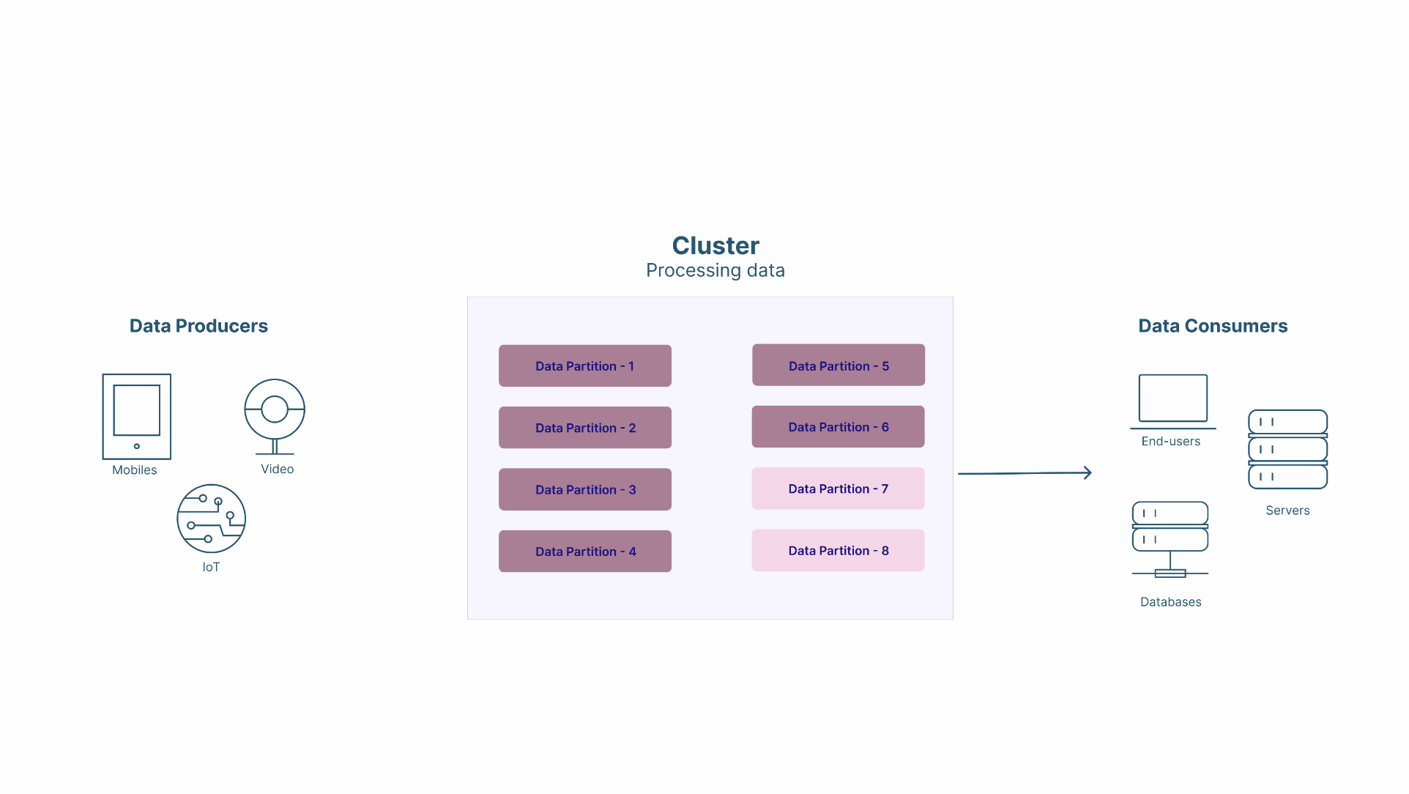
What is streaming data?

Slide 5
When to use streaming data
There are several flags that point towards using data streams:
Databases can't keep up with the flow of data being generated
The importance of processing real-time is much more important that just "having" the data
There are multiple sources generating data and multiple sources that would need to consume that same data
Volumes would be too high to process it in batches.
If your use-case ticks (almost) all the above boxes, you should consider using streaming data.

Slide 6
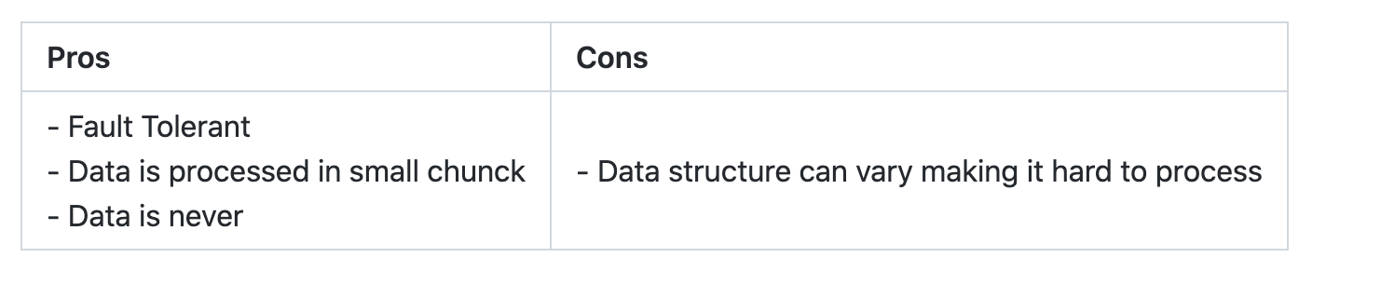
Pros & Cons of using streaming data
Now, using streaming data offers a lot of advantages but it comes at a cost. Here is a quick recap:

Slide 7
How to use streaming data?
There are a lot of different tools to process streaming data. Among them are:
Apache Kafka
Amazon MSK
Amazon Kinesis
Google Pub/Sub
One of the most popular is Apache Kafka as it is Open Source. That is why this is the one we will be covering in the next lectures.

